Slide 1

Sedar:
Obtaining High-Quality Seeds for DBMS Fuzzing
via Cross-DBMS SQL Transfer
武伊雪

Slide 2

INTRODUCTION

Slide 3
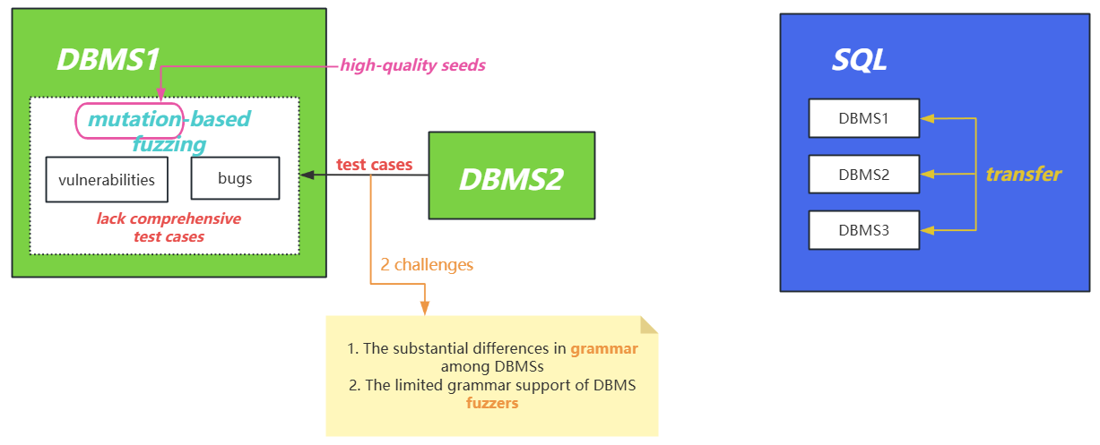
MOTIVATION (high-quality seeds for fuzzing)

Slide 4
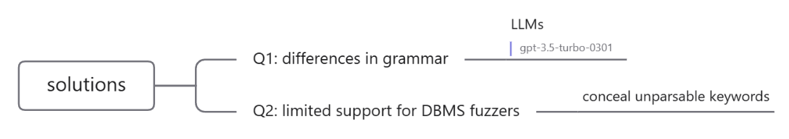
SOLUTIONS

Slide 5
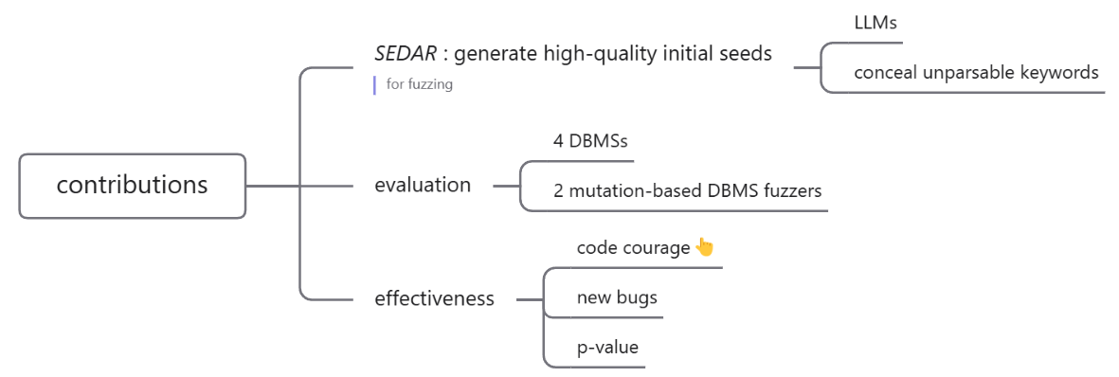
CONTRIBUTIONS

Slide 6
IMPLEMENTATIONS

Slide 7
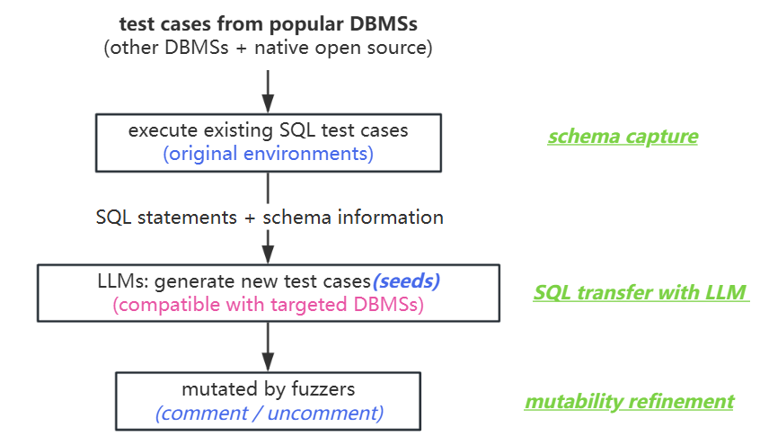
OVERVIEW
(3 steps)

Slide 8
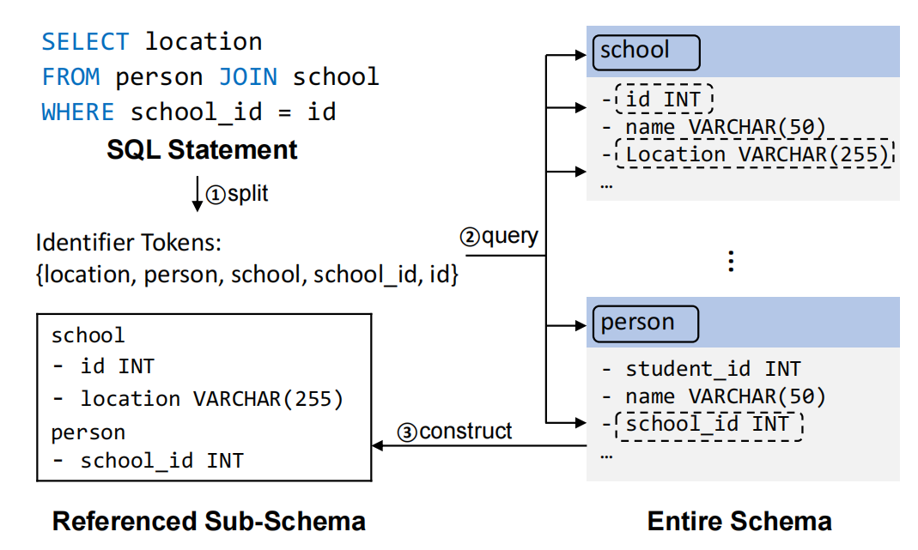
step1:
Schema Capture
eg:
“SELECT... WHERE a=b”
(the data types of the columns “a” and “b” are ambiguous)
“a=b::BOOL” or “a=b::TEXT”
(but in PostgreSQL, it requires explicit type casting)

Slide 9
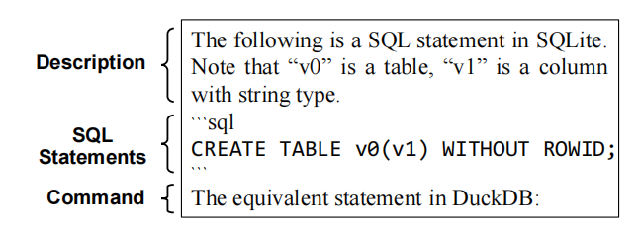
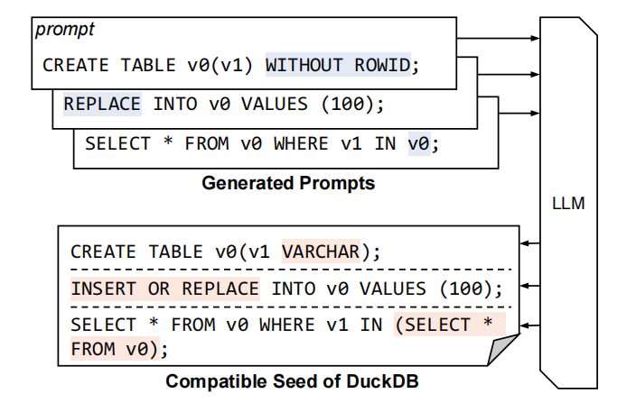
step2: SQL Transfer with LLM
-> natural language summary:
{item_name} is a {item_type}
prompt genaration
LLM query
directly

Slide 10

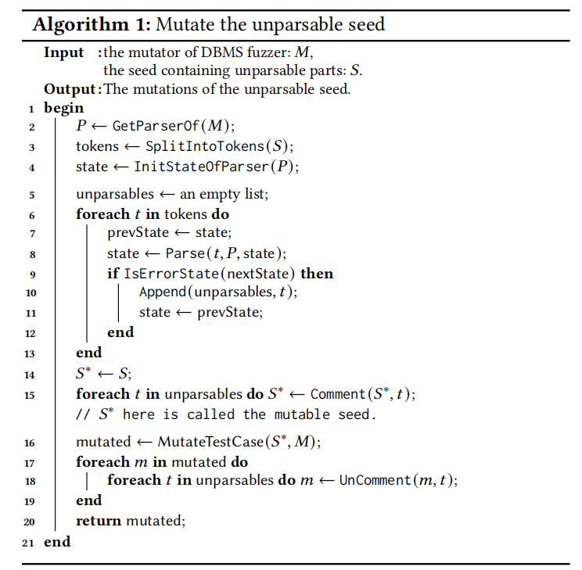
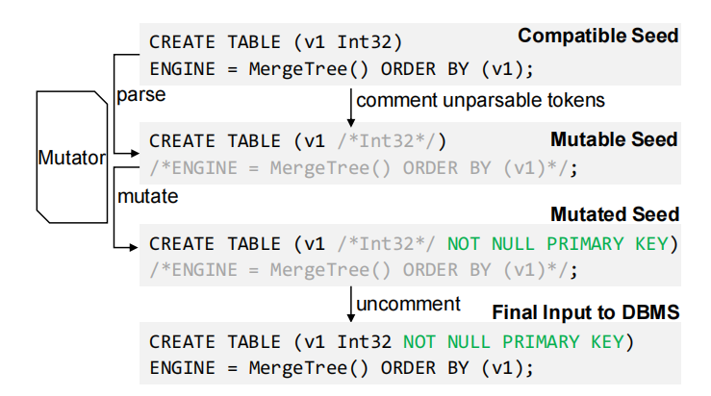
step3: Mutability Refinement
comment / uncomment

Slide 11
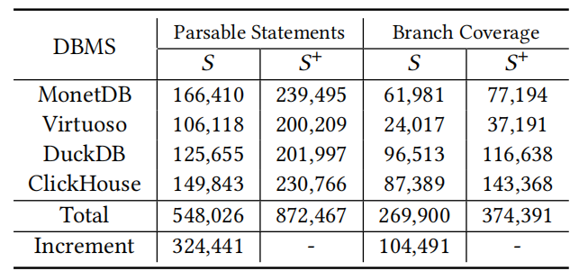
step3: Mutability Refinement
TABLE: : The number of statements in compatible seeds and mutable seeds
MORE

Slide 12
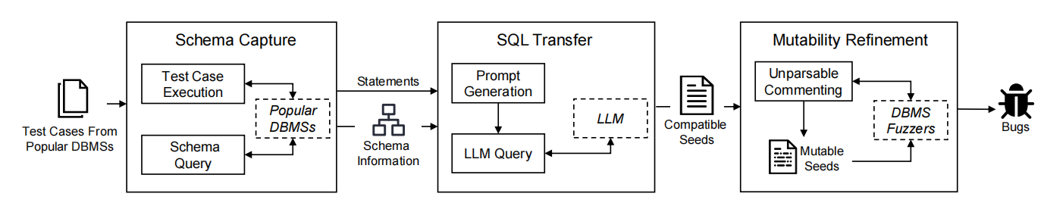
OVERVIEW

Slide 13
EVALUATION
(1) code courage + efficiency of seeds generation
(2) bug detecting
(3) p-value

Slide 14
Evaluation Setup
tested DBMSs | MonetDB , Virtuoso, DuckDB, ClickHouse
DBMS Fuzzers | Griffin and Sqirrel (two mutation-based DBMS fuzzers)
Collected Test Cases | built-in test cases from other DBMS repositories (SQLite, MySQL, and PostgreSQL)

Slide 15
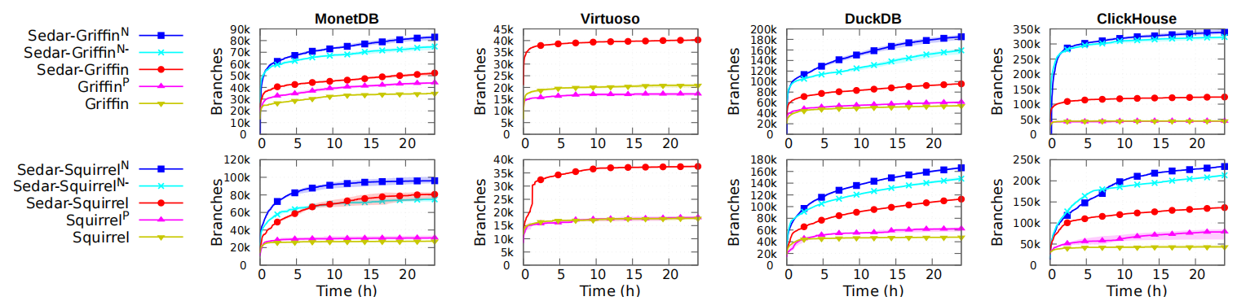
(1) Code Courage +
Efficiency of Seeds Genaration
native + SEDAR
native + mutation
SEDAR
other DBMSs(without transferring)
built-in

Slide 16
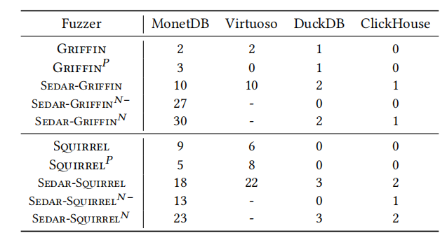
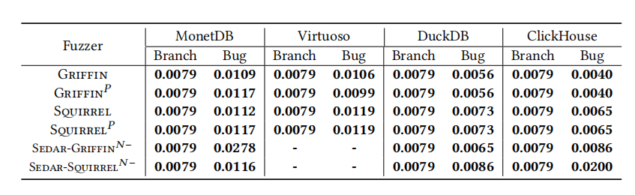
(2) Bug Detecting
(3) p-value
--inconsistence
the number of bugs detected

Slide 17
DISCUSSION

Slide 18
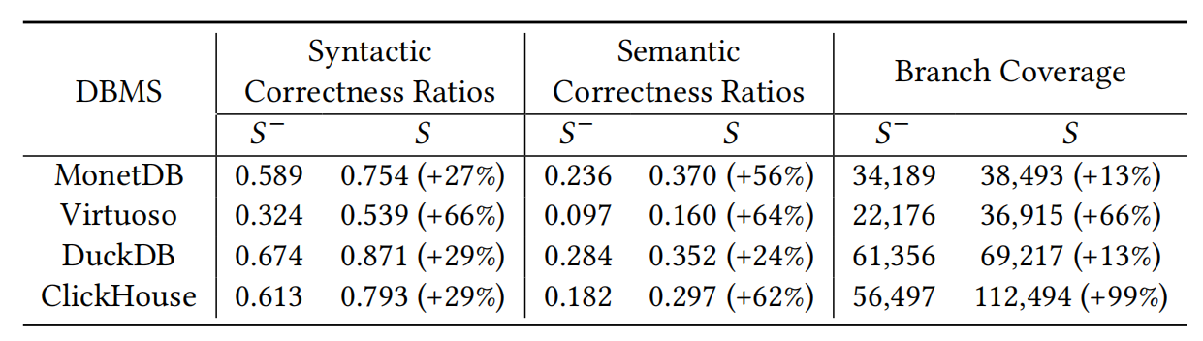
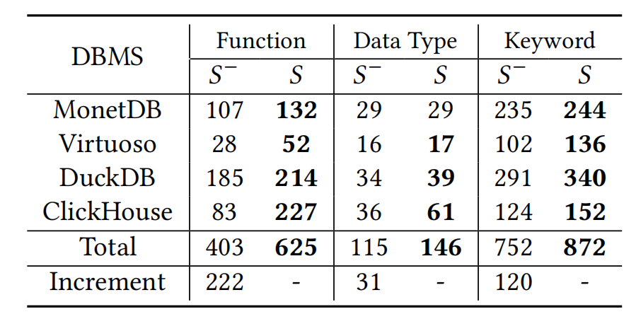
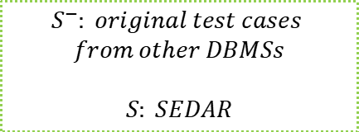
Contribution
$$S^{−}: original test cases$$
$$from other DBMSs$$
$$S: SEDAR$$
The correct syntactic structures in the semantically correct statements

Slide 19
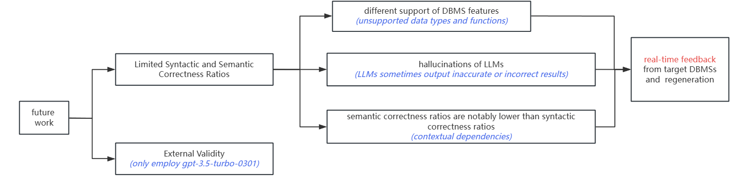
Future Work

Slide 20

Thank you
Thank You

